Slide 1
Collaboration, Advocacy, and Recruitment
Marion Frank-Wilson, Indiana University

Slide 2
Area and International Studies Librarianship Workshop
October 30-31, 2013 at Indiana University-Bloomington
Organized by members of IU Bloomington Libraries’ Area Studies Department:
Wookjin Cheun
Marion Frank-Wilson
Luis Gonzalez
Akram Khabibullaev
Wen-Ling Liu
Todd Ramlo

Slide 3
Supported by:
The IU Libraries
Mellon Foundation Innovating International Research, Teaching, and Collaboration grant

Slide 4
This Presentation Will Provide an Overview of the Workshop
Workshop format
Documents/themes created before the workshop
Discussion of main themes that emerged from workshop discussions and presentations
Explore next steps

Slide 5
Workshop Website Includes Detailed Information
www.indiana.edu/~libarea/main.html
About the workshop
Workshop format
Agenda
Workshop themes
Provocations and responses
Biographies of presenters
Bibliography

Slide 6
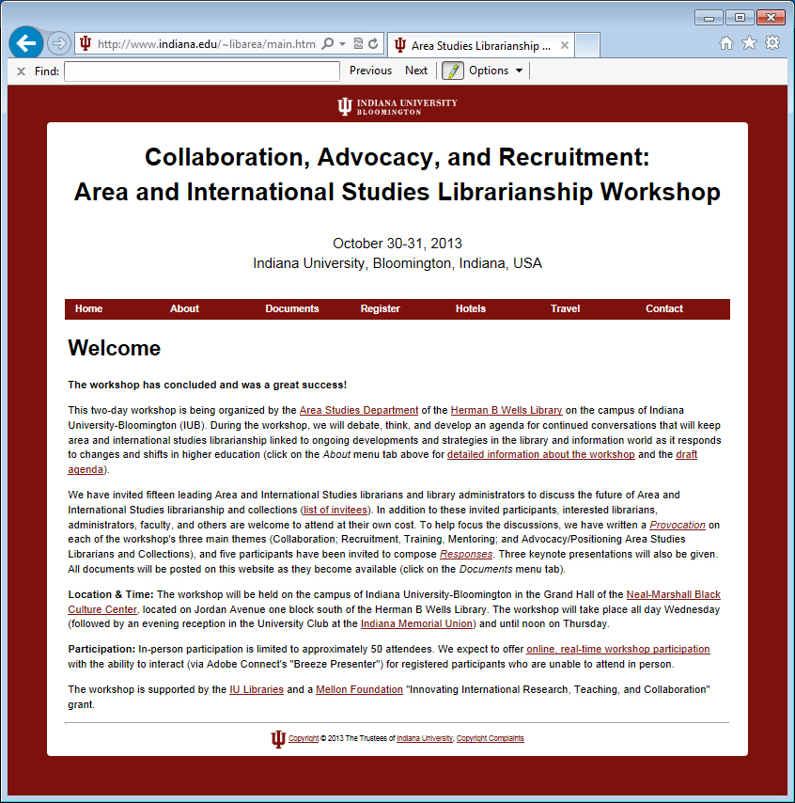
Screenshot of Homepage

Slide 7
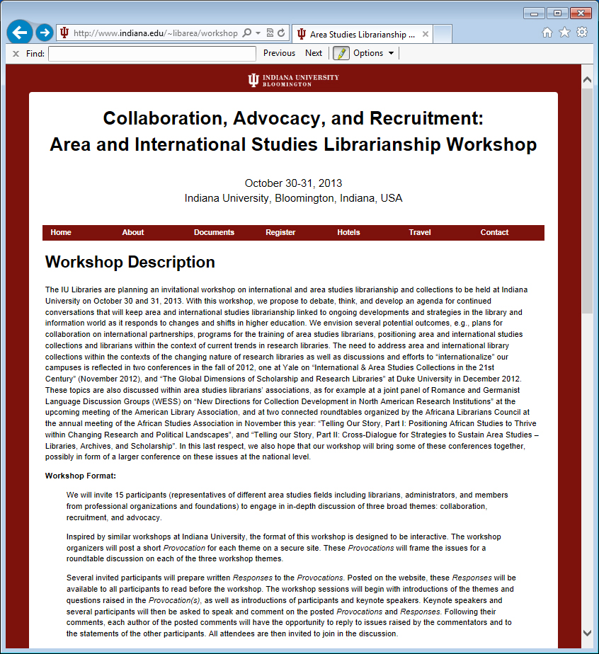
Screenshot of About the Workshop

Slide 8
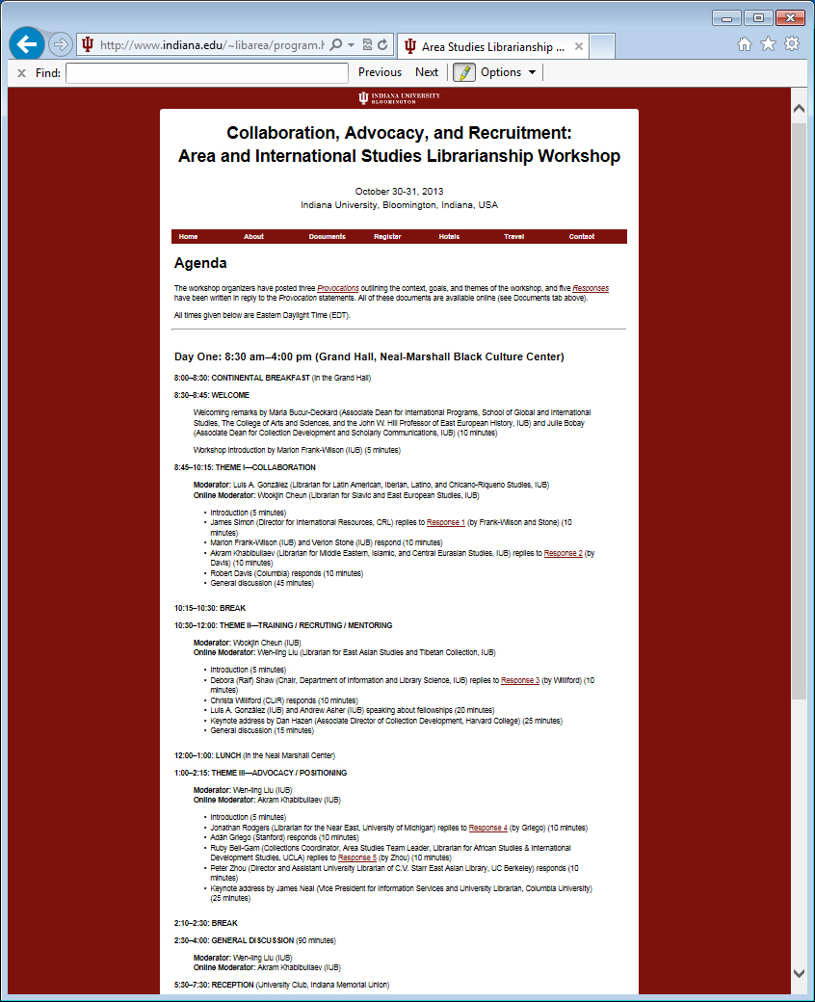
Screenshot of Agenda (Day 1)

Slide 9
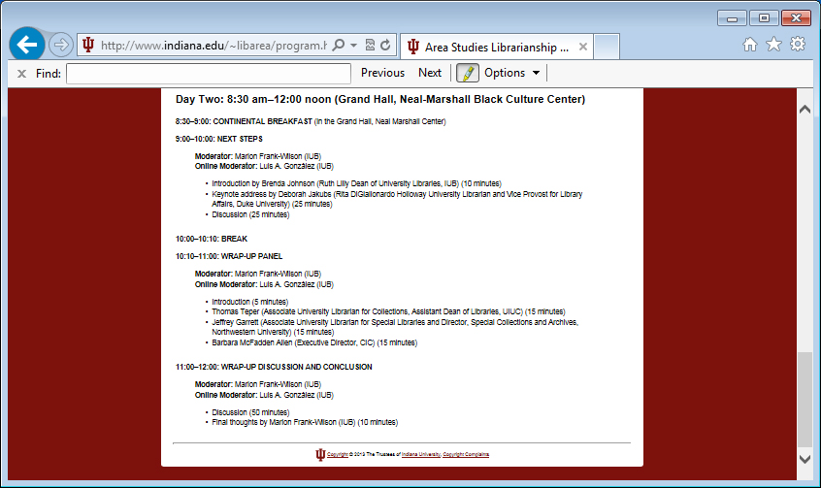
Screenshot of Agenda (Day 2)

Slide 10
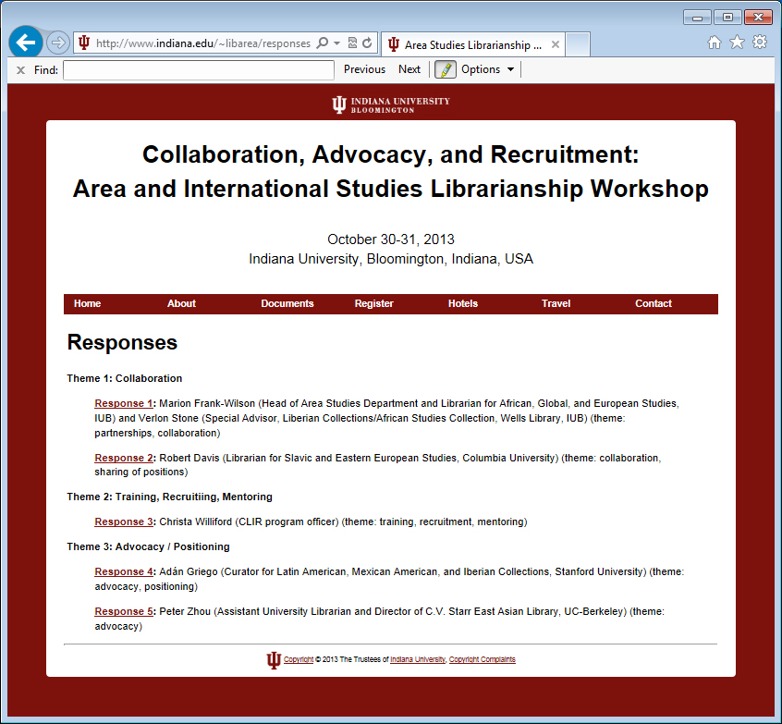
Screenshot of Responses

Slide 11
Interactive workshop format
Collaborative scholarly conference model
Allowing opportunities for debate, continuing conversations, collective solutions

Slide 12
Provocations on Each Workshop Theme
Collaboration
Advocacy
Recruitment

Slide 13
Participants
16 leading Area and International Studies librarians and library administrators
5 participants were invited to respond to the provocations prior to workshop
3 keynote speakers provided additional perspectives

Slide 14
Theme I – Collaboration
What kinds of partnerships will take us into the future?
What forms of collection development should we practice to build strong and relevant collections?
What kinds of collaborative strategies can be developed to archive web resources?
Shared librarian positions – what are their implications for collection development?

Slide 15
Theme II – Advocacy
How can we demonstrate value and impact of our collections and services?
With changes in the academy, publishing, and the information landscape, how can we position our collections as central to the mission of the university?
What are the implications of current focus on globalization in education for Area and International Studies collections?

Slide 16
Theme III – Recruitment and Training
What kind of training will produce area librarians with language skills and subject background?
How can LIS curricula prepare professional area librarians?
How can we collaborate on training programs?

Slide 17
Wide Range of Opinions, Viewpoints, and Insights Expressed
Provocations
Responses to provocations
Presentations
Discussions

Slide 18
Some Highlights: Collaboration
“Regional, national, international collaborations are a way to create and coordinate deeper collections, but so far, these efforts have been selective, episodic, and shallow.” (keynote speaker Jim Neal)
Call for creation of digital collections through partnerships, with regular assessment of such partnerships
Need to collectively advocate for the creation of “cyber collections” (Peter Zhou) for materials outside the U.S.
Call for more coordination, sharing, borrowing from each other to free up resources and to enhance discovery of materials
Lack of approach to archive born-digital content
Shared librarian positions among several institutions as a way to create deeper collections rather than as a cost-saving measure

Slide 19
Some Highlights: Advocacy
Counteract image of area studies collections as relevant to only small number of specialized faculty; emphasize similarities, not differences
Constantly demonstrate value of area librarians in building international partnerships
Remind administrators of essential value of our collections (keynote speaker Deborah Jakubs)
Importance of outreach at the local, national and international level
Use of social media for outreach
Call for a national Council of Area Librarianship Association

Slide 20
Some Highlights: Recruitment and Training
Call for flexibility with respect to hiring area librarians
Consider models other than the MLS as viable training for area librarians, e.g. CLIR and/or Mellon fellowships
Development of online course for area studies librarianship as a way to ensure future talent in the profession

Slide 21
Next Steps
Strategic Priorities for the Future as Identified by Keynote Speaker Jim Neal
Special and distinctive collections
Digital resources/collections
Effective interfaces, improved access
User spaces
Support for teaching and learning
Support for research and scholarship
Preservation and archiving
Calls for radical approach to collaboration in this context

Slide 22
“Mainstreaming” area librarians (keynote speaker Deborah Jakubs) by integrating them into newly configured academic programs
Conferences and workshops
Need to focus discussions about future of collections on the user (keynote speaker Dan Hazen)
Stop looking for users like us, i.e., humanists (Hazen)
Call for a “deliberate digital turn” is complex (Hazen, “Going Digital in the Area Studies World: Pipedream or Necessity?”, see workshop proceedings)
Need for new and diverse skill sets among area librarians

Slide 23
Concrete Steps and Possibilities
Continued outreach and advocacy at local, national and international levels by area librarians
Continued conversations, such as the Duke Global Forum and the IU Workshop
Consider a larger conference devoted to further develop selected themes
Expand international partnerships either through our institutions or through area studies librarian associations

Slide 24
Crucial Next Steps
Creation of unified cyber laws (Zhou)
Creation of union list of digital content/project
Develop strategies for archiving of web content which involve international partners

Slide 25
Next Steps at IU
Exploration of several projects, hope to collaborate
Online, open access publication of workshop proceedings in the near future

